Slide 1
Desktop Object Identification and Tracking
Kevin DuCharme &
Max Li
Notes:
Hello and welcome all to our presentation. We are Kevin and Max and today we will be talking to you about out project, desktop object identification and tracking.

Slide 3
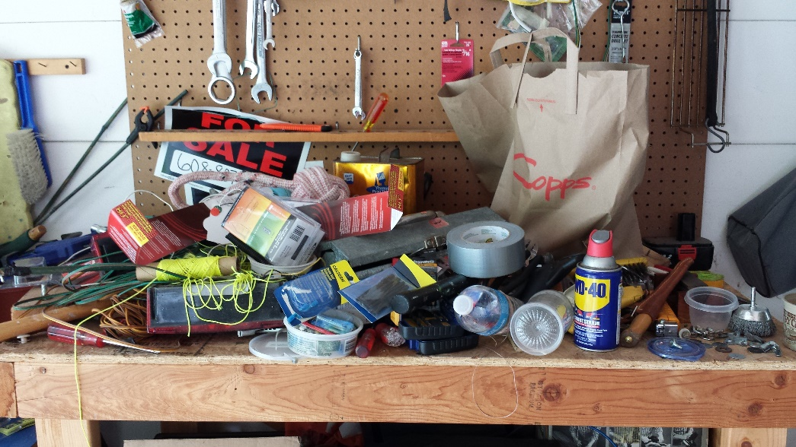

Motivation
The main motivation behind this project is the struggle of finding items on a heavily used desk. On an active workbench, tools and other useful items are frequently getting picked up, used, and placed down somewhere else. While good standard operating procedures will make sure all the parts end up where they're expected to be, it's very easy to quickly lose track of items.
Notes:
The main motivation behind this project is the struggle of finding items on a heavily used
desk. On an active workbench, tools and other useful items are frequently getting picked
up, used, and placed down somewhere else. While good standard operating procedures will
make sure all the parts end up where they're expected to be, it's very easy to quickly lose
track of items.

Slide 4
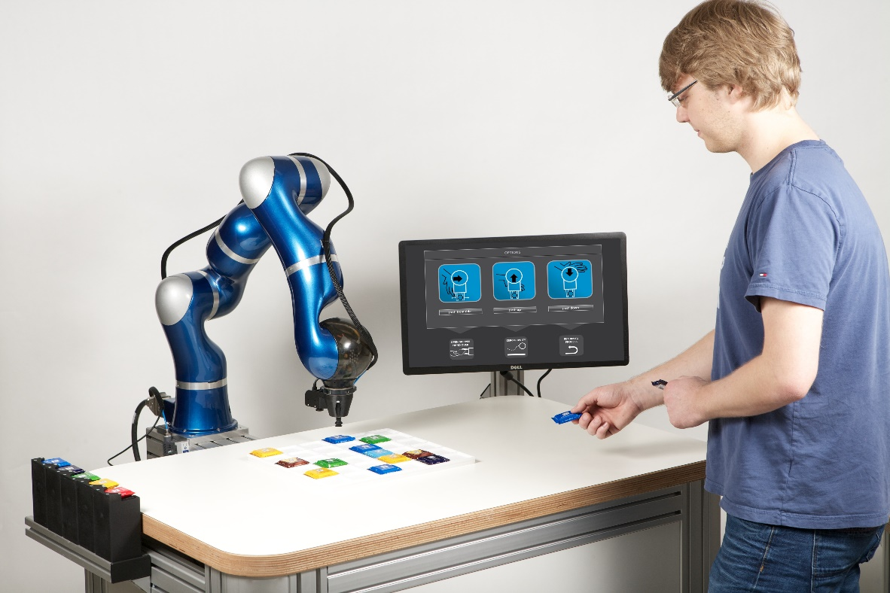
Introduction
Starting the framework for a lab assistant robot
Detect and track pre-trained common workbench items
Notes:
The goal of this project is to start the foundation of a lab assistant robot that has the
capability of tracking common items found on a workbench in pseudo real-time. When a
user queries the robot, it should be able to tell the user where a specific tool is, in a way
that would make sense to the user. Initially, the objects being identified would come from
a preset bank of objects that have been pre-trained. However, the end product will likely
have to be trainable on new objects by the user.
For this project, the main topic of focus is object tracking. After all, the rest of the
features are both fairly difficult (and thus time-consuming), and out of scope of the computer
vision task. As such, the goal is to be able to detect a number of different objects, identify
what they are, and track them as they move across a camera.

Slide 5
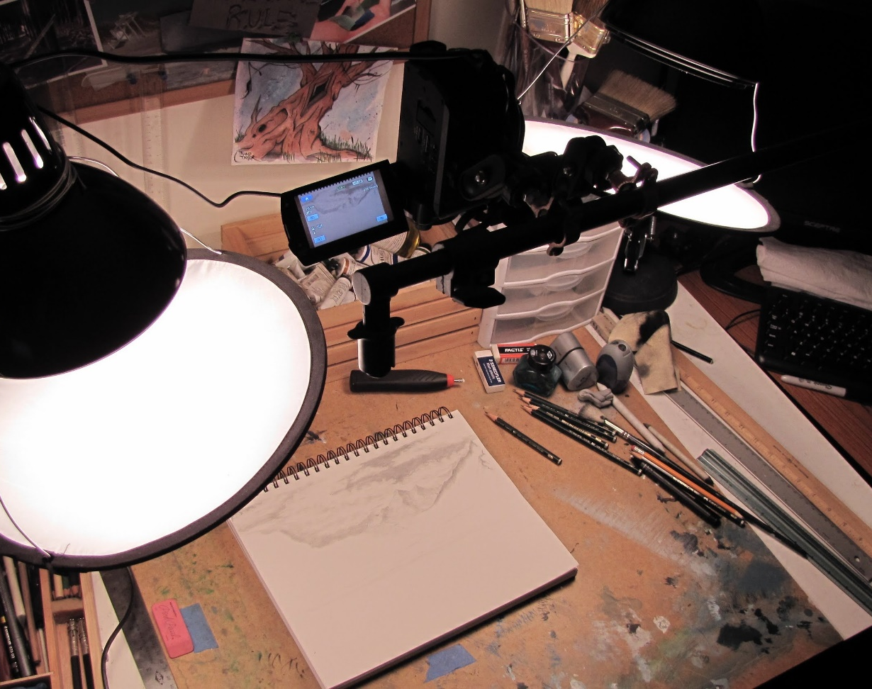
Desk Camera Configuration
Controlled Environment
Keep setup simple
Top-down viewing camera
Kept well-lit
Reduced clutter for initial implementation
Notes:
We wanted to control our environment to ease our ingress into the world of computer vision using deep learning networks. While later on this network can be refined to better handle clutter and various lighting conditions, We wanted to remove those distractions so that we could focus on the object detection and tracking aspect.

Slide 6
Single Shot Detectors
Theme Fonts:
Verdana (heading)
Verdana (body)
Drawing Style Default:
Sample
Sample
Sample
Text Box Default:
Verdana 16pt
Color: Black
Align: Center Line Spacing: Multiple .95 Space Before: 6pt
For labels only – use layout placeholders for bulleted lists
Line Style Default:

Slide 7
Transfer Learning
First level bullet text, Verdana 24pt
Line spacing 0.95, before paragraph 12pt
Left justified
Sentence case
First level bullet color is accent1
Second level bullet Verdana 20pt
Line spacing 0.95, before paragraph 6pt
Third level
Third level
Fourth level

Slide 8
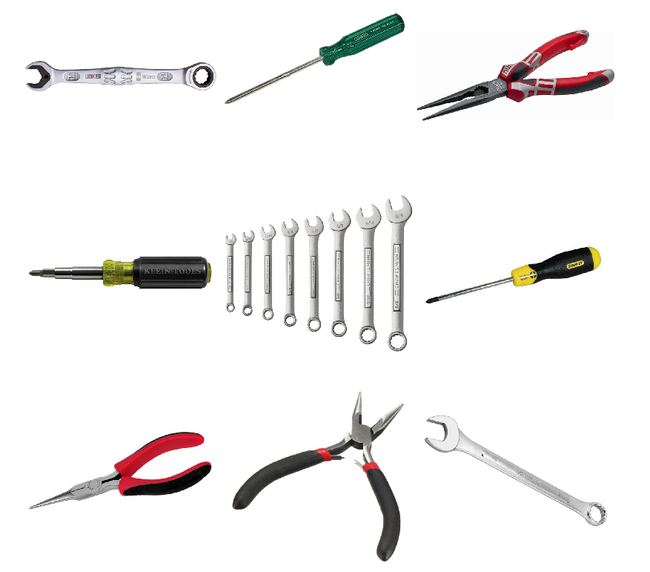
Building New Image Dataset
The project was limited to three classes: Wrenches, Pliers, and Screwdrivers.
Each category contains ~150 sample images
Images are of various resolutions
Only data augmentation was scaling down high resolution images
Notes:
Creating your own dataset can be a time consuming and arduous process and because of that we limited this project to three classes: Wrenches, Pliers, and Screwdrivers. Using a combination of Google and Bing image searches, along with image-net.org, about 150 sample images was collected for each class. The images had a wide range of resolutions which helps with providing robustness to the trained model. During training, we did run into some memory issues due to some of the ridiculously large image resolutions. I am not sure who needs a 4k x 4k image of a pair of pliers, but our computers where none too happy with it. Instead of reducing our samples by removing the images, we resized the images down to something more manageable.

Slide 9
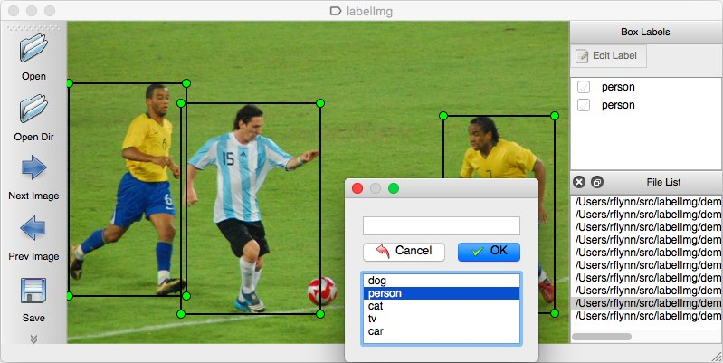
Bounding Box Labels
Photo description

Slide 10
Creating TF records and config
First level bullet text, Verdana 24pt
Line spacing 0.95, before paragraph 12pt
Left justified
Sentence case
First level bullet color is accent1
Second level bullet Verdana 20pt
Line spacing 0.95, before paragraph 6pt
Third level
Third level
Fourth level

Slide 11
Training New Model
First level bullet text, Verdana 24pt
Line spacing 0.95, before paragraph 12pt
Left justified
Sentence case
First level bullet color is accent1
Second level bullet Verdana 20pt
Line spacing 0.95, before paragraph 6pt
Third level
Third level
Fourth level

Slide 12
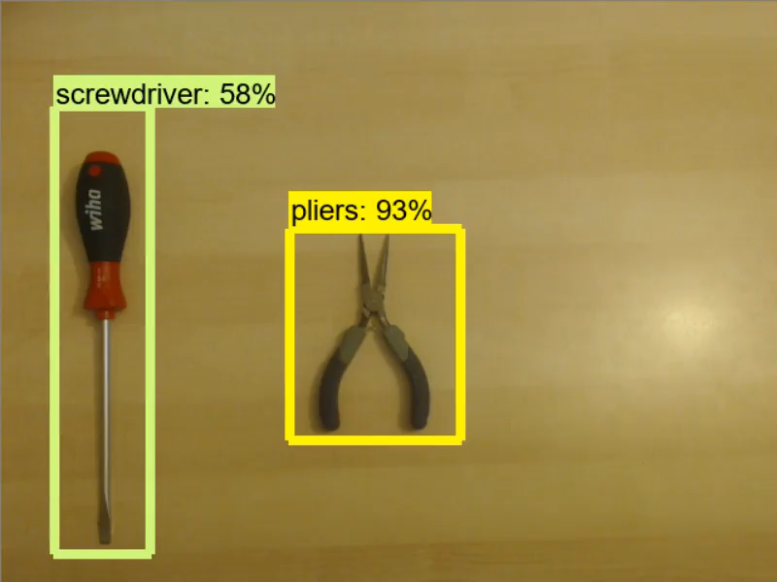
Real-time Detection (No Tracking)

Slide 13
Tracking
First level bullet text, Verdana 24pt
Line spacing 0.95, before paragraph 12pt
Left justified
Sentence case
First level bullet color is accent1
Second level bullet Verdana 20pt
Line spacing 0.95, before paragraph 6pt
Third level
Third level
Fourth level

Slide 14
Results
First level bullet text, Verdana 24pt
Line spacing 0.95, before paragraph 12pt
Left justified
Sentence case
First level bullet color is accent1
Second level bullet Verdana 20pt
Line spacing 0.95, before paragraph 6pt
Third level
Third level
Fourth level

Slide 15
Improvements
First level bullet text, Verdana 24pt
Line spacing 0.95, before paragraph 12pt
Left justified
Sentence case
First level bullet color is accent1
Second level bullet Verdana 20pt
Line spacing 0.95, before paragraph 6pt
Third level
Third level
Fourth level

Slide 16
Future Work
First level bullet text, Verdana 24pt
Line spacing 0.95, before paragraph 12pt
Left justified
Sentence case
First level bullet color is accent1
Second level bullet Verdana 20pt
Line spacing 0.95, before paragraph 6pt
Third level
Third level
Fourth level

Slide 17
Questions
First level bullet text, Verdana 24pt
Line spacing 0.95, before paragraph 12pt
Left justified
Sentence case
First level bullet color is accent1
Second level bullet Verdana 20pt
Line spacing 0.95, before paragraph 6pt
Third level
Third level
Fourth level

Slide 19
Layout: SectionDivider, Verdana Bold 40pt
Divider Subtext Verdana 28 pt

Slide 20
Layout: Title and Content Verdana Bold 32pt
First level bullet text, Verdana 24pt
Line spacing 0.95, before paragraph 12pt
Left justified
Sentence case
First level bullet color is accent1
Second level bullet Verdana 20pt
Line spacing 0.95, before paragraph 6pt
Third level
Third level
Fourth level

Slide 21
Layout: Two Content
First level bullet, Verdana 22pt
Line spacing 0.95, before paragraph 10pt
Left justified
Sentence case
First level bullet color is accent 1
Second level bullet
Third level
First level bullet, Verdana 22pt
Line spacing 0.95, before paragraph 10pt
Left justified
Sentence case
First level bullet color is accent 1
Second level bullet
Third level

Slide 22
Color Scheme
White–Background
R255 G255 B255
Accent 1
R171 G25 B45
Black
R0 G0 B0
Accent 2
R178 G183 B187
Red R171 G25 B45
Accent 3 R44 G106 B140
Grey
R109 G109 B109
Accent 4
R183 G160 B121
Accent 5 R70 G160 B220
Accent 6
R109 G109 B109

Slide 23
Default Settings
Theme Fonts:
Verdana (heading)
Verdana (body)
Drawing Style Default:
Sample
Sample
Sample
Text Box Default:
Verdana 16pt
Color: Black
Align: Center Line Spacing: Multiple .95 Space Before: 6pt
For labels only – use layout placeholders for bulleted lists
Line Style Default:

Slide 24
Default Table Style
Heading 1 | Heading 2 | Heading 3 | Heading 4 | Heading 5
Content | Content | Content | Content | Content
Content | Content | Content | Content | Content
Content | Content | Content | Content | Content
Content | Content | Content | Content | Content

Slide 25
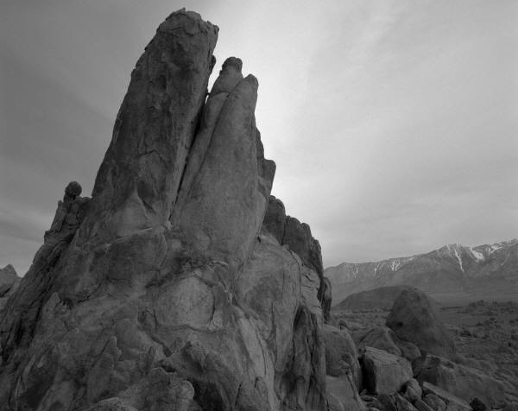
Layout: PhotoCaption
Photo description

Slide 26
Layout: Content Column Chart Sample
Notes:
BEST PRACTICES:
Open Excel 2007 before creating charts in PowerPoint
Duplicate this slide and edit data

Slide 27
Layout: Two Content Column Chart Sample
First level bullet text
Line spacing 0.95, before paragraph 12pt
Left justified
Sentence case
First level bullet color is accent 2
Second bullet level
Line spacing 0.95, before paragraph 6pt
Notes:
BEST PRACTICES:
Open Excel 2007 before creating charts in PowerPoint
Duplicate this slide and edit data

Slide 28
Layout: Content Line Chart Sample
Notes:
BEST PRACTICES:
Open Excel 2007 before creating charts in PowerPoint
Duplicate this slide and edit data

Slide 29
Layout: Two Content Line Chart Sample
First level bullet text
Line spacing 0.95, before paragraph 12pt
Left justified
Sentence case
First level bullet color is accent 2
Second bullet level
Line spacing 0.95, before paragraph 6pt
Notes:
BEST PRACTICES:
Open Excel 2007 before creating charts in PowerPoint
Duplicate this slide and edit data

Slide 30
Layout: Content Pie Chart Sample
Notes:
BEST PRACTICES:
Open Excel 2007 before creating charts in PowerPoint
Duplicate this slide and edit data

Slide 31
Layout: Two Content Pie Chart Sample
First level bullet text
Line spacing 0.95, before paragraph 12pt
Left justified
Sentence case
First level bullet color is accent 2
Second bullet level
Line spacing 0.95, before paragraph 6pt
Notes:
BEST PRACTICES:
Open Excel 2007 before creating charts in PowerPoint
Duplicate this slide and edit data

